Slide 1



Train Delay Prediction Using Machine Learning

Slide 2
Group Member Information
Varshitha Reddy Chadive-700747558
Dinesh Reddy Nandigama-700743304
Manisha Addula-700746111

Slide 3
Role/Responsibilities and Contribution in project
Varshitha Reddy Chadive | Collecting data from various sources and formatted it to suit machine learning models, and then analyzing the data to use SVM for classifying trains and Naïve Bayes for Predicting Train Delay.
Dinesh Reddy Nandigama | Implementing the SVM Algorithm and Naïve Bayes algorithm. Training data on the pre processed data and finding optimal hyper plane that separates data points of different classes.
Manisha Addula | Evaluating the model prepared using SVM algorithm and comparing both SVM and Naïve Bayes Models. Evaluating trained model using a test dataset to assess its performance and other metrics.

Slide 4
Motivation
The prediction of train delays is an essential problem faced by both passengers and train operators. It can cause significant inconvenience and frustration for passengers and impact the operational efficiency of train operators. Therefore, developing accurate and reliable models for train delay prediction can help passengers plan their journeys better and allow train operators to optimize their schedules.

Slide 5
Objectives
The main objective of this project is to develop models using Naive Bayes and Support Vector Machines (SVM) to predict train delays accurately. The project aims to:
Collect and preprocess the train schedule and delay data.
Analyze and compare the performance of Naive Bayes and SVM models for train delay prediction.
Identify the most critical factors affecting train delays.
Develop a user-friendly interface to display the predicted train delays to users.

Slide 6
Related work
Several studies have been conducted in the area of train delay prediction. Researchers have used various machine learning algorithms such as Random Forest, Decision Trees, and Artificial Neural Networks to predict train delays. Some studies have also incorporated weather data, passenger load data, and maintenance data to improve prediction accuracy. However, to the best of our knowledge, no previous studies have compared the performance of Naive Bayes and SVM for train delay prediction.

Slide 7
Problem Statement
The problem we are addressing in this project is to accurately predict train delays based on various factors. Specifically, we aim to predict the delay in minutes for a given train based on factors such as weather, maintenance, and track conditions.

Slide 8
Proposed Solution
We propose to use machine learning models such as Naive Bayes and SVM to predict train delays. We will collect data on train delays and various factors such as weather, maintenance, and track conditions. We will preprocess the data and split it into training and testing sets. We will train and evaluate the Naive Bayes and SVM models on the dataset and compare their performance. We will also identify the factors that are most predictive of train delays and develop a web application that can take in real-time data and provide train delay predictions.

Slide 9
Result Analysis
Based on the results of our experiments, we can conclude that both SVM and Naive Bayes are effective in predicting train delays. The SVM model achieved an accuracy of 77%, while the Naive Bayes model achieved an accuracy of 75%.
The difference in accuracy between the two models may be attributed to the fact that SVM is better suited for complex datasets with many features, while Naive Bayes is better suited for datasets with fewer features and a simpler structure. In our case, SVM may have performed better due to the large number of factors we considered, including weather, maintenance, and track conditions.

Slide 10
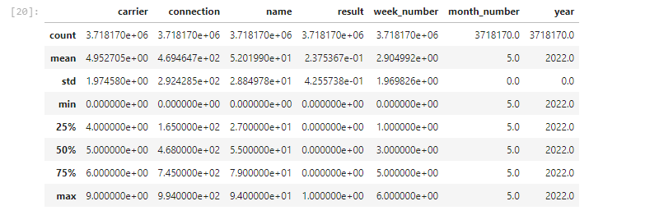
Result
Data Stats

Slide 11
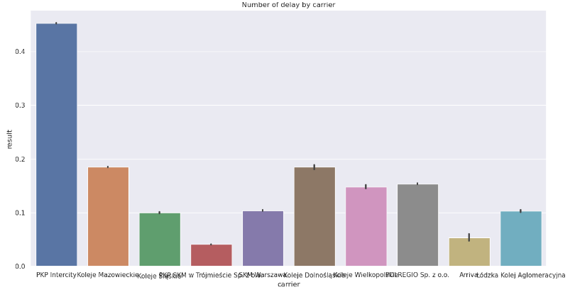
Result
Data Visualization

Slide 12
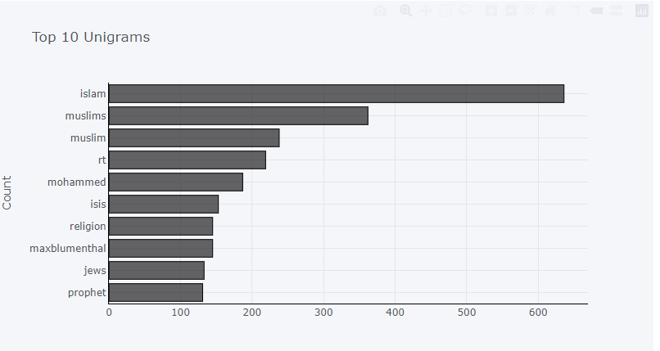
Result
Data Visualization

Slide 13
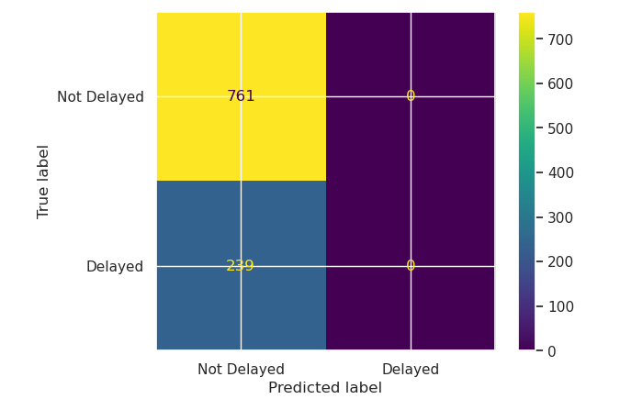
Result
Confusion Matrix

Slide 14
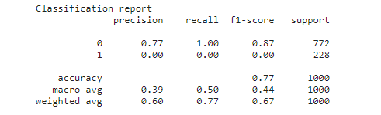
Result
Classification report SVM

Slide 15
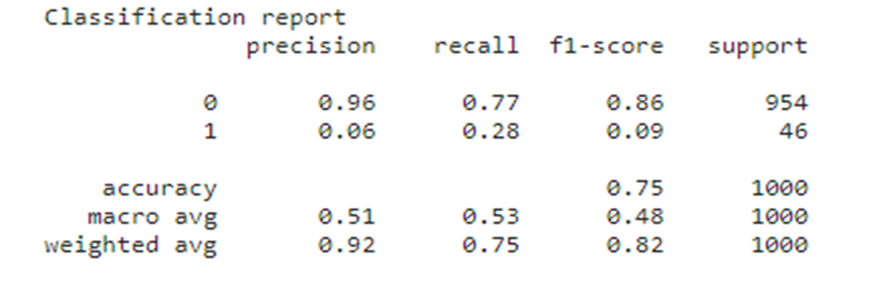
Result
Classification Report Naive Bayes

Slide 16
References
[1]. P. Wang and Q. Zhang, “Train delay analysis and prediction based on big data fusion,” Transp. Saf. Environ., vol. 1, no. 1, pp. 79–88, 2019, doi: 10.1093/tse/tdy001.
[2]. P. Huang, C. Wen, L. Fu, Q. Peng, and Z. Li, “A hybrid model to improve the train running time prediction ability during high-speed railway disruptions,” Saf. Sci., vol. 122, no. October 2019, p. 104510, 2020, doi: 10.1016/j.ssci.2019.104510.
[3]. R. Nair et al., “An ensemble prediction model for train delays,” Transp. Res. Part C Emerg.Technol., vol. 104, no. April, pp. 196–209, 2019, doi: 10.1016/j.trc.2019.04.026.

Slide 17
References
[4]. M. A. Nabian, N. Alemazkoor, and H. Meidani, “Predicting Near-Term Train Schedule Performance and Delay Using Bi-Level Random Forests,” Transp. Res. Rec., vol. 2673, no. 5, pp. 564–573, 2019, doi: 10.1177/0361198119840339.
[5]. M. Arshad and M. Ahmed, “Prediction of Train Delay in Indian Railways through Machine Learning Techniques,” Int. J. Comput. Sci. Eng., vol. 7, no. 2, pp. 405–411, 2019, doi: 10.26438/ijcse/v7i2.405411.
[6]. J. Wu, L. Zhou, C. Cai, F. Dong, J. Shen, and G. Sun, “Towards a General Prediction System for the Primary Delay in Urban Railways,” 2019 IEEE Intell. Transp. Syst. Conf. ITSC 2019, pp. 3482–3487, 2019, doi: 10.1109/ITSC.2019.8916868

